Slide 1
TIS Solutions Appraisal System
Presenter
Sanath

Slide 2
Contents
Meaning
Description
Objectives Of Appraisal
Graphic Rating Scales
Use Case Diagram
SQL Tables Creation
Insertion Of Values
Output Of Tables

Slide 3
Meaning
A “Performance Appraisal” is a process of evaluating an employee’s Performance of a job in terms of its requirements.
Performance Appraisal is the step where the management find out how effective it has been at hiring and placing employees.

Slide 4
Description
TIS Solutions has great work with their employees, with this in TIS Solutions they have increasing number of employees.
In the EMPLOYEE APPRAISAL APP all employees can know their performance with employee appraisal app. This performance can be given in yearly, half-yearly, or quarterly to their employees.
This Appraisal module allows you to create evaluation plans and give timely feedback and compliments for accomplishments. By knowing all their performances employees will know all their accomplishments and they can perform better next time.

Slide 5
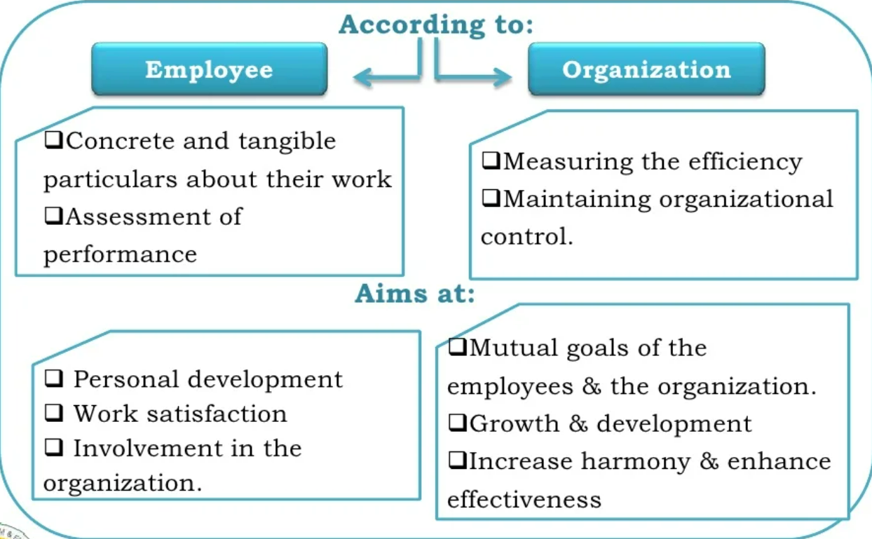
Objectives Of Appraisal

Slide 6
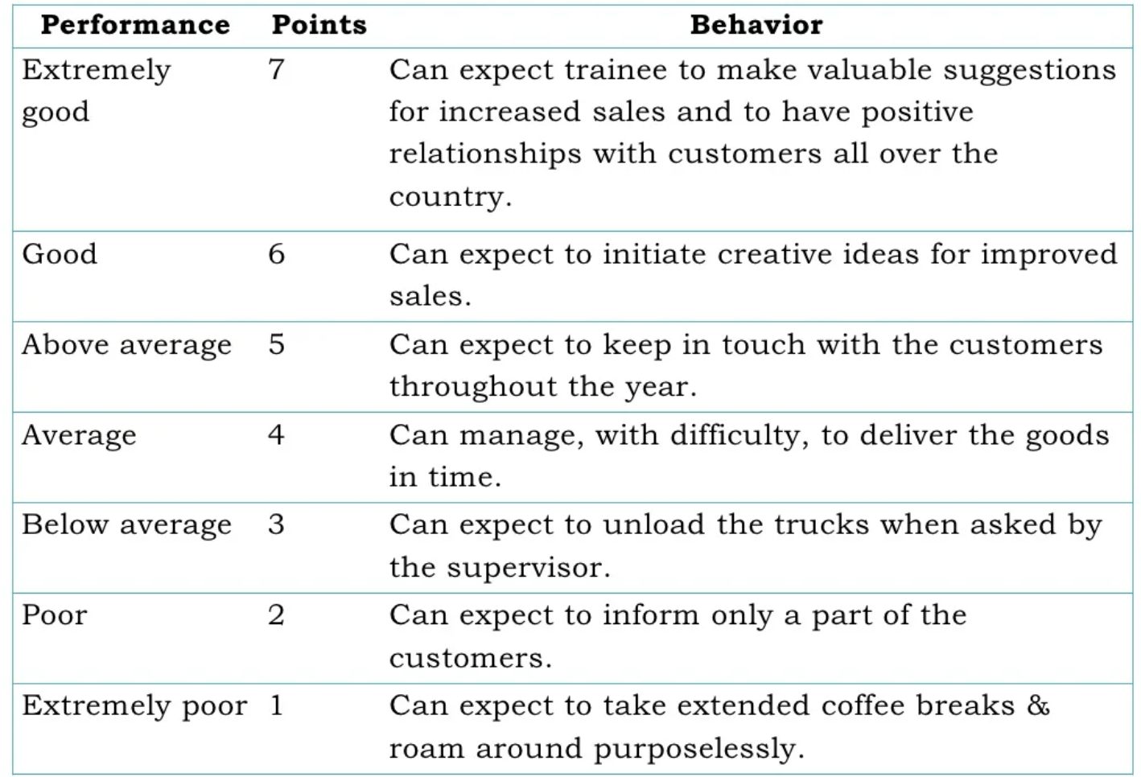
Graphic Rating Scales
A scale that lists a number of attribute and a range of performance for the each. The employee is then rated by identifying the score that best describes performance for each attribute.

Slide 7
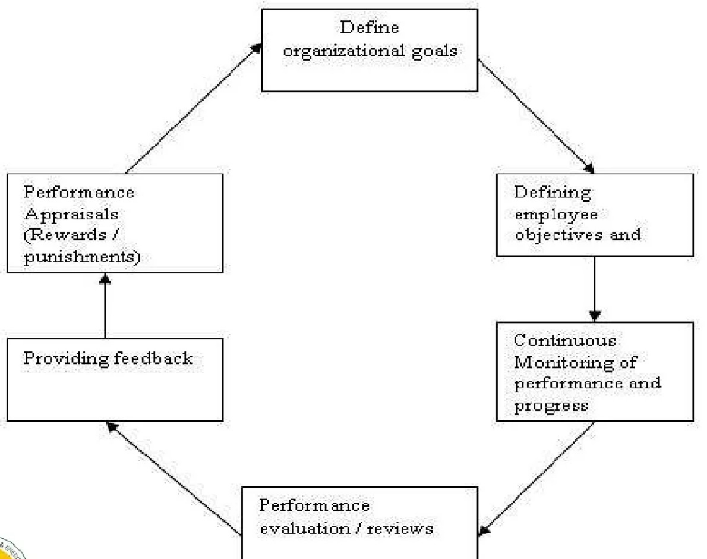
Use Case Diagram

Slide 8
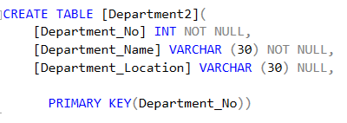
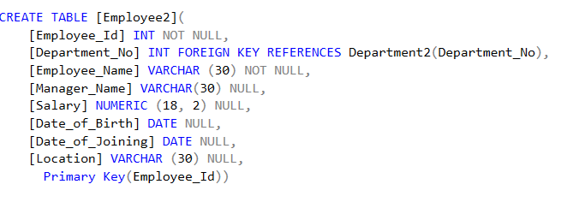
SQL Tables Creation
The following table called “Employee2" that contains seven columns: EmployeeID, EmpName, MgrName ,DeptNo, Salary, Dob ,Doj and Loc
The following table called “Department2" that contains five columns: DeptNo, DeptName and DeptLocation

Slide 9
Insertion Of Values
The following SQL statement inserts a new record in the “Employee" table:
INSERT [Employee2] [Employee_Id], [DepartmentNo], [Employee_Name], [Manager_Name] [Salary],[Date_of_Birth], [Date_of_Joining], [Location]) VALUES (101,10 ,'Kumar', 'ram‘, (22000.00 ), CAST('1965-01-01' AS Date), CAST('1980-04-01' AS Date),'New Delhi')
INSERT [Employee2] ([Employee_Id], [DepartmentNo], [Employee_Name], [Manager_Name], [Salary],[Date_of_Birth], [Date_of_Joining], [Location]) VALUES (102,20, 'Sajeev', ‘jeeva’,(25000.00), CAST('1965-01-01' AS Date), CAST('1980-04-01' AS Date), ‘Chennai’)
INSERT [Employee2] ([Employee_Id], [DepartmentNo], [Employee_Name], [Manager_Name] [Salary],[Date_of_Birth], [Date_of_Joining], [Location]) VALUES (103,30 'Sreeja',’Sufi’, (22000.00), CAST('1965-01-01' AS Date), CAST('1980-04-01' AS Date), ‘Hyderabad')

Slide 10
Insertion Of Values
The following SQL statement inserts a new record in the “Department" table:
INSERT [department2] ([Department_Id],[Department_Name],[Department_Location]) VALUES (10,'HR','New Delhi')
INSERT [department2] ([Department_Id],[Department_Name],[Department_Location]) VALUES (20,'Marketing', 'New Delhi')
INSERT [department2] ([Department_Id],[Department_Name], [Department_Location]) VALUES (30,'Sales', 'New Delhi')

Slide 11
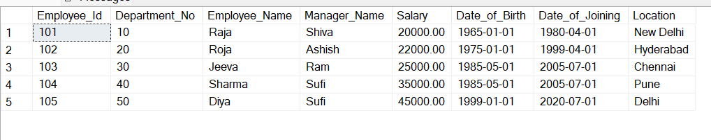
Output Of Tables
The Output from the “Employee" table will now look like this:

Slide 12
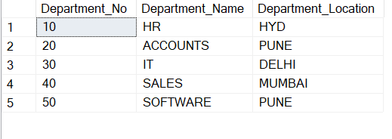
Output Of Tables
The Output from the “Department" table will now look like this:

Slide 13
Thank You

